Slide 1


Slide 2



Slide 3
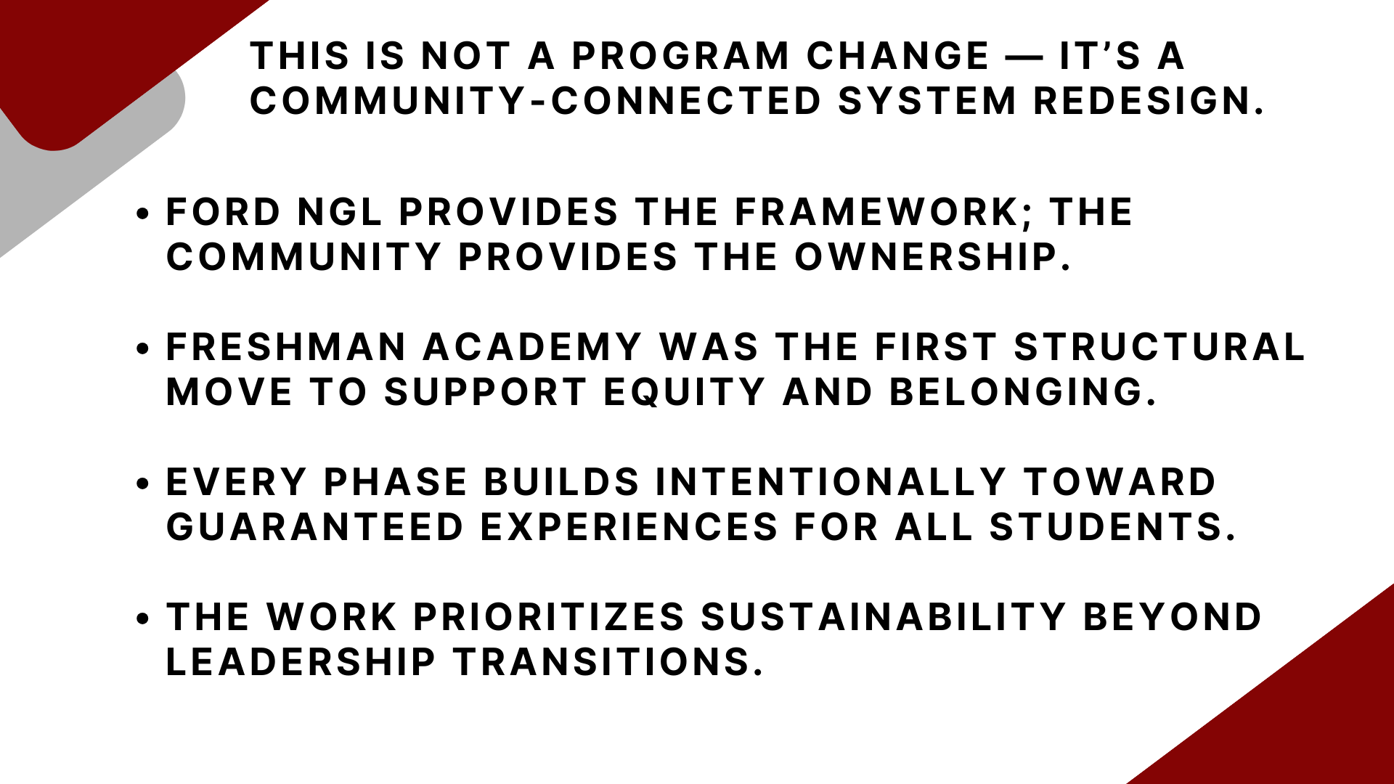

Slide 4
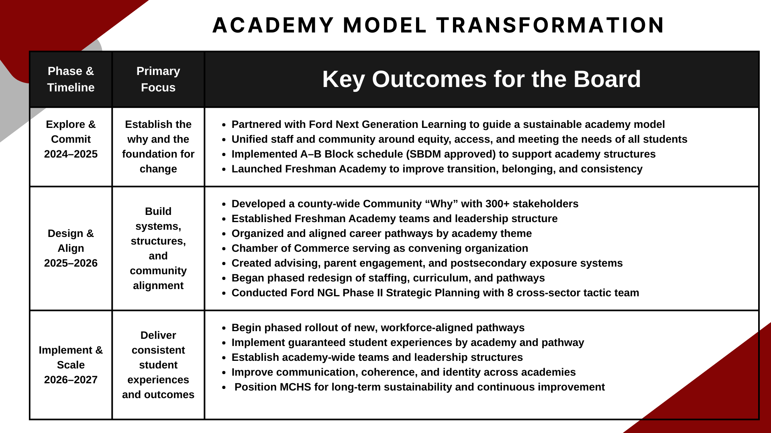

Slide 5
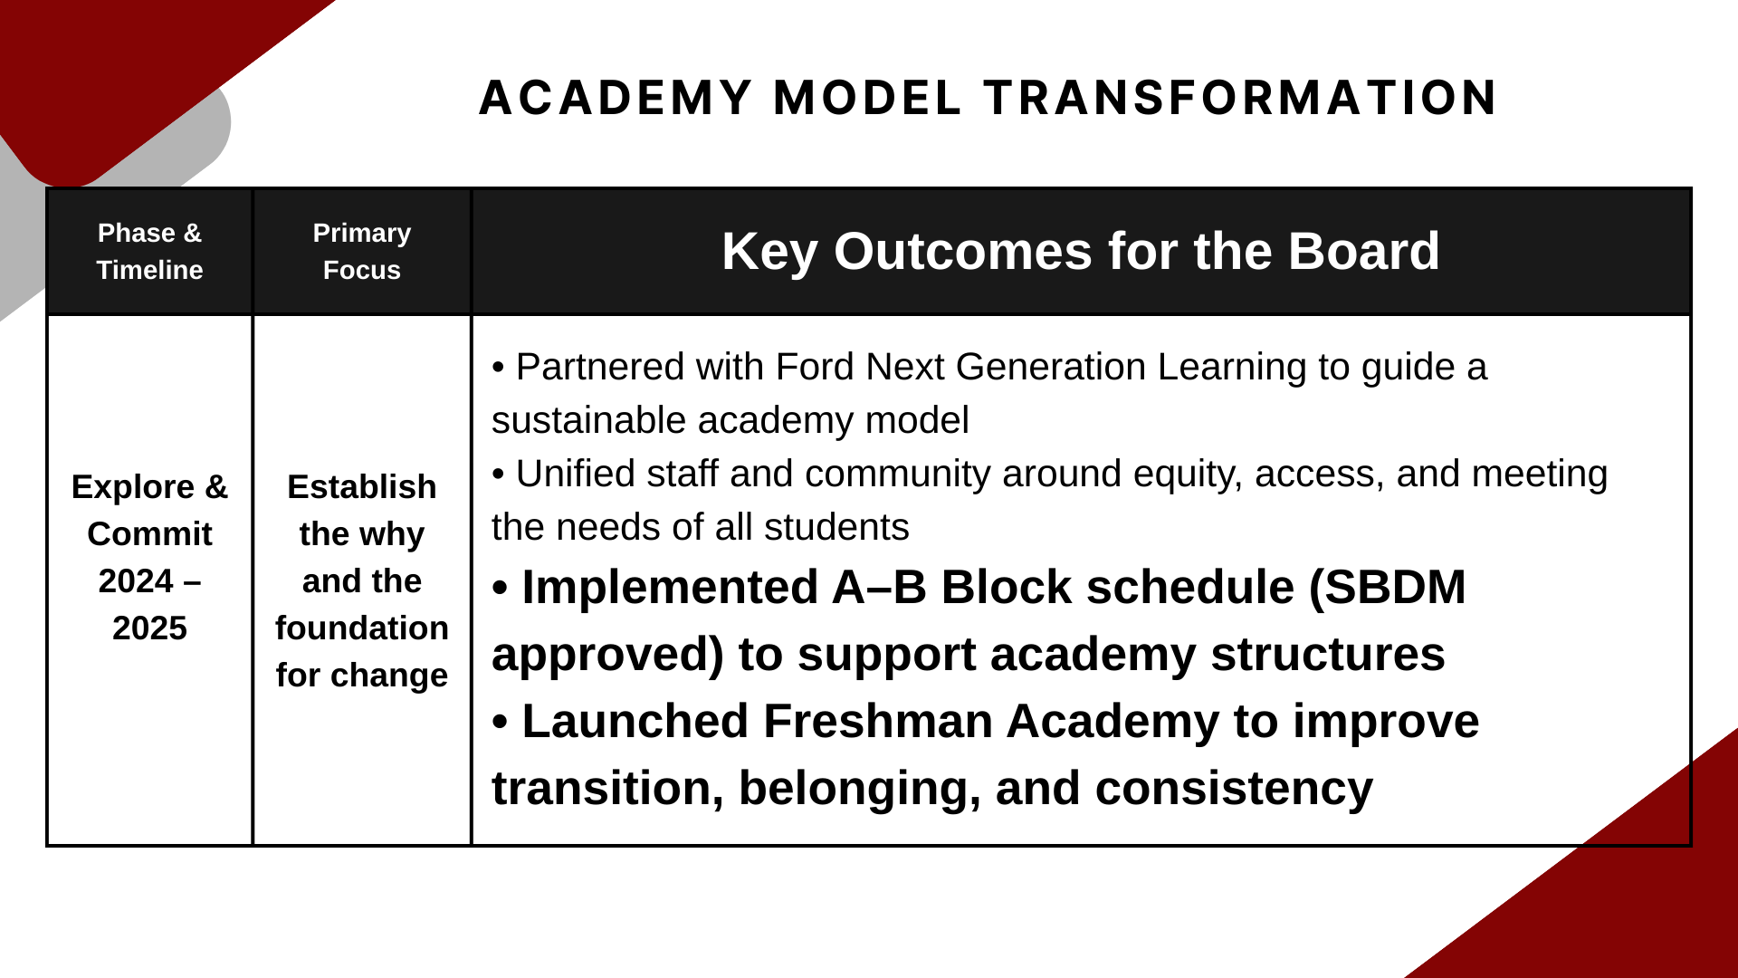

Slide 6
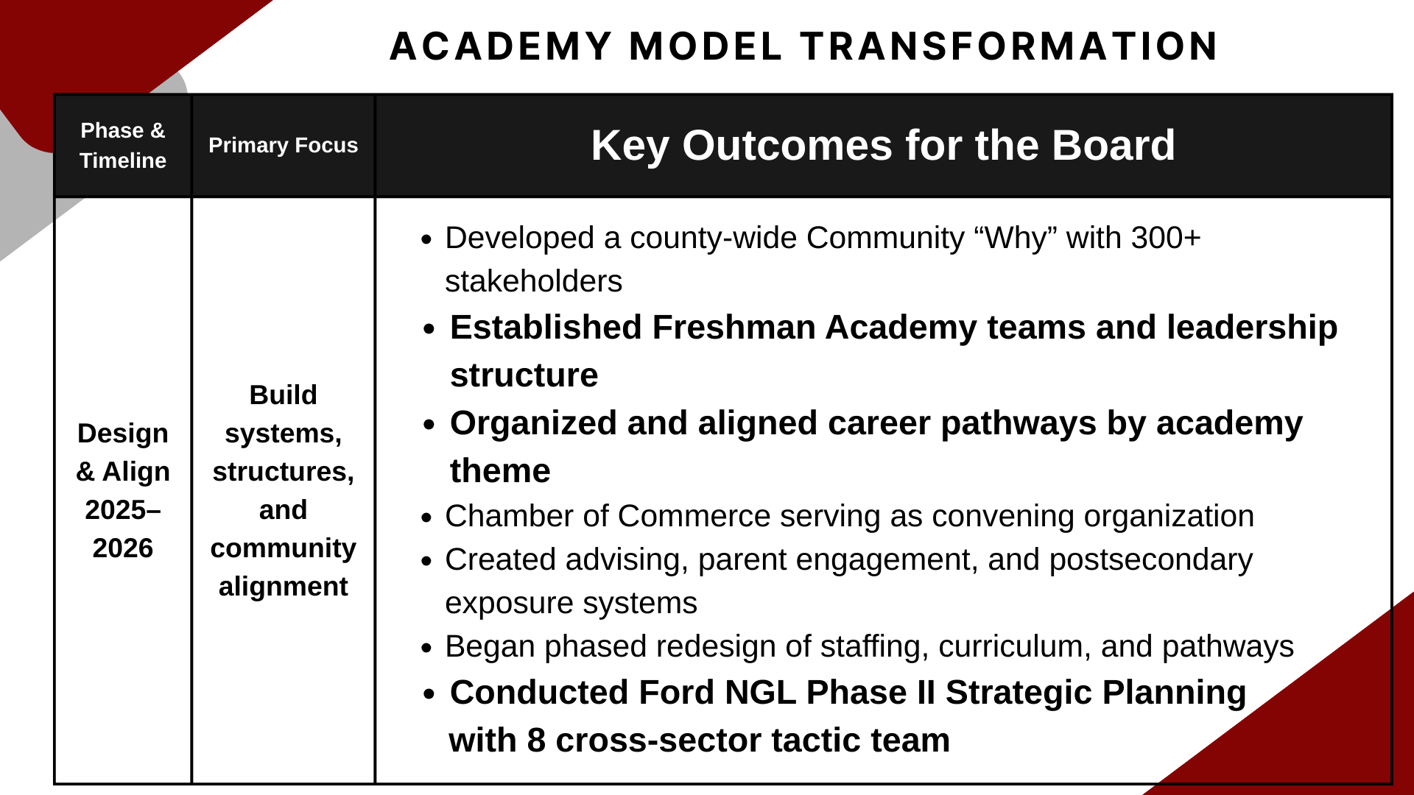

Slide 7
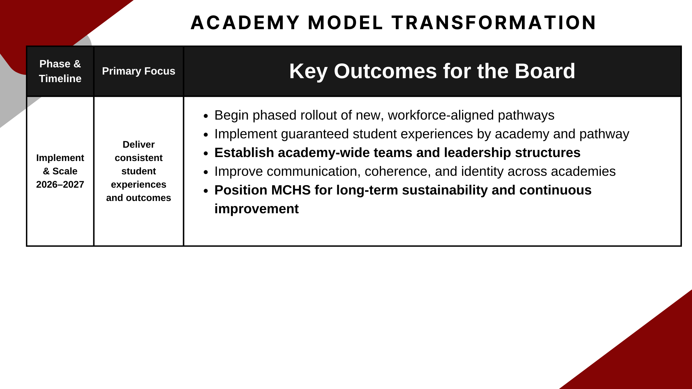
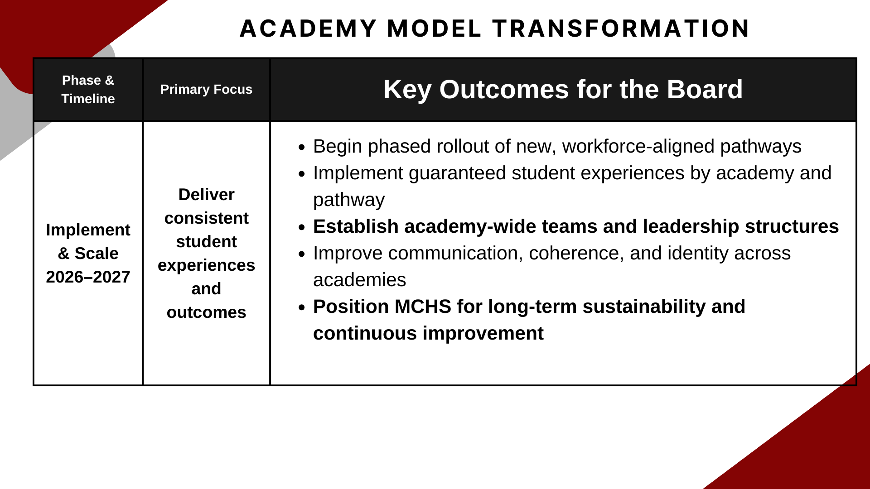

Slide 8
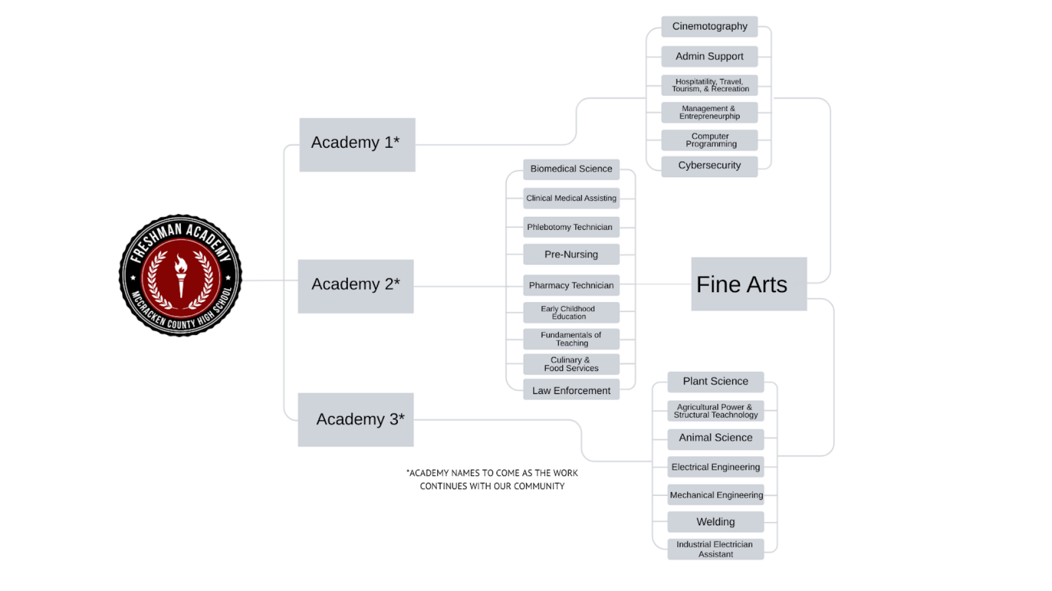

Slide 9



A Blueprint for Powerful and Sustainable Partnerships
Notes:
Set the stage that any community has a lot of businesses and several schools that will be calling on them. Next four slides–5 min
8:22-8:23

Slide 10
Proposed Approach
Convening Organization w/Community Coordinator
Academy Coach

Slide 11
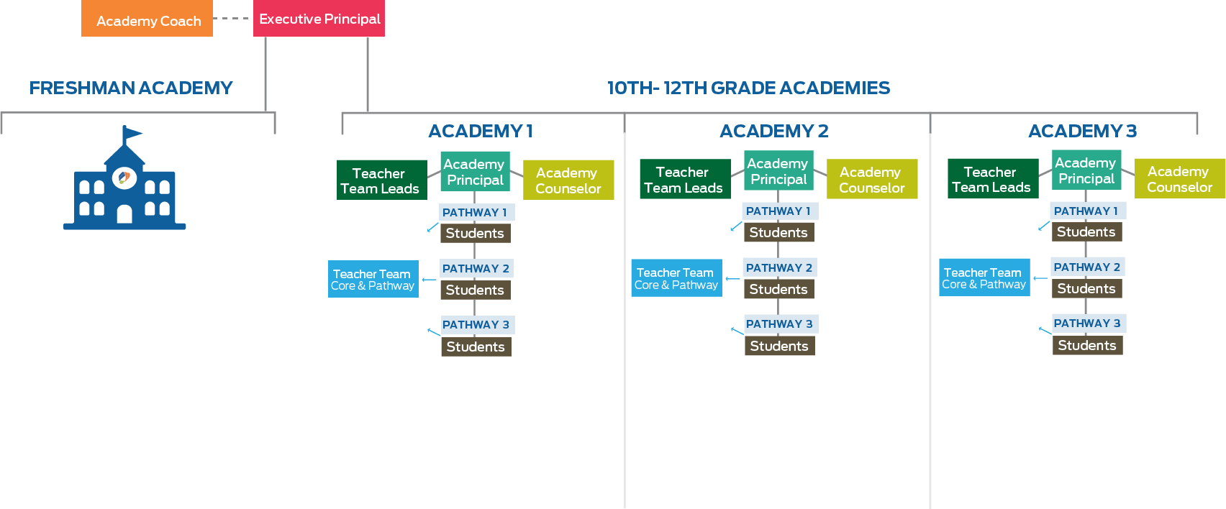
WALL-TO-WALL
ACADEMIES
Convening Organization w/Community Coordinator

Slide 12
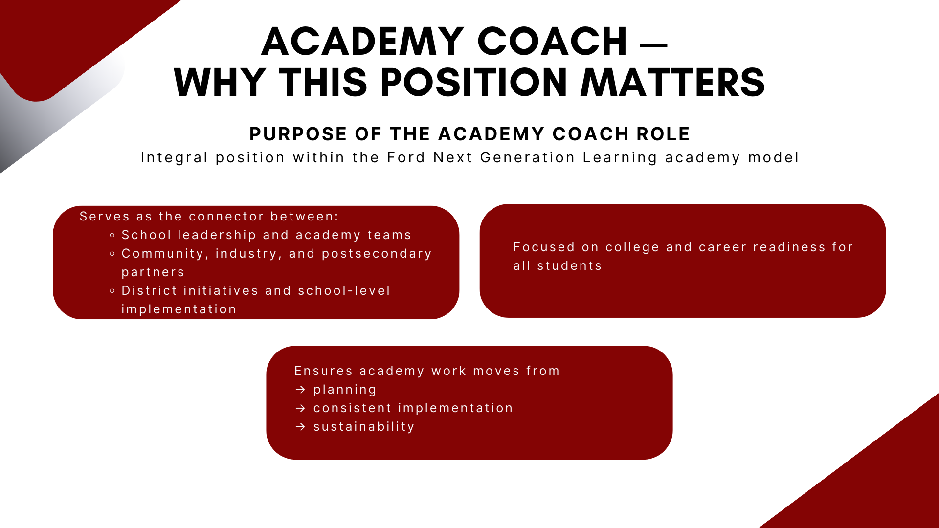
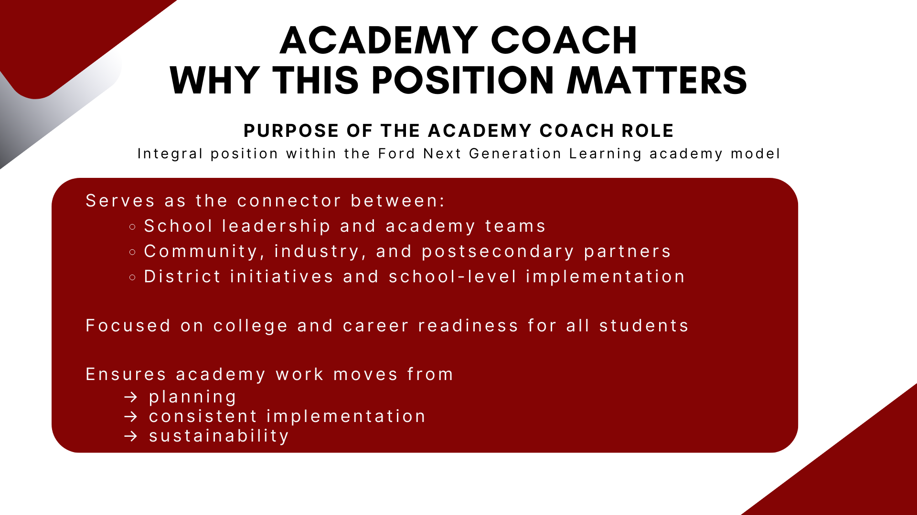

Slide 13
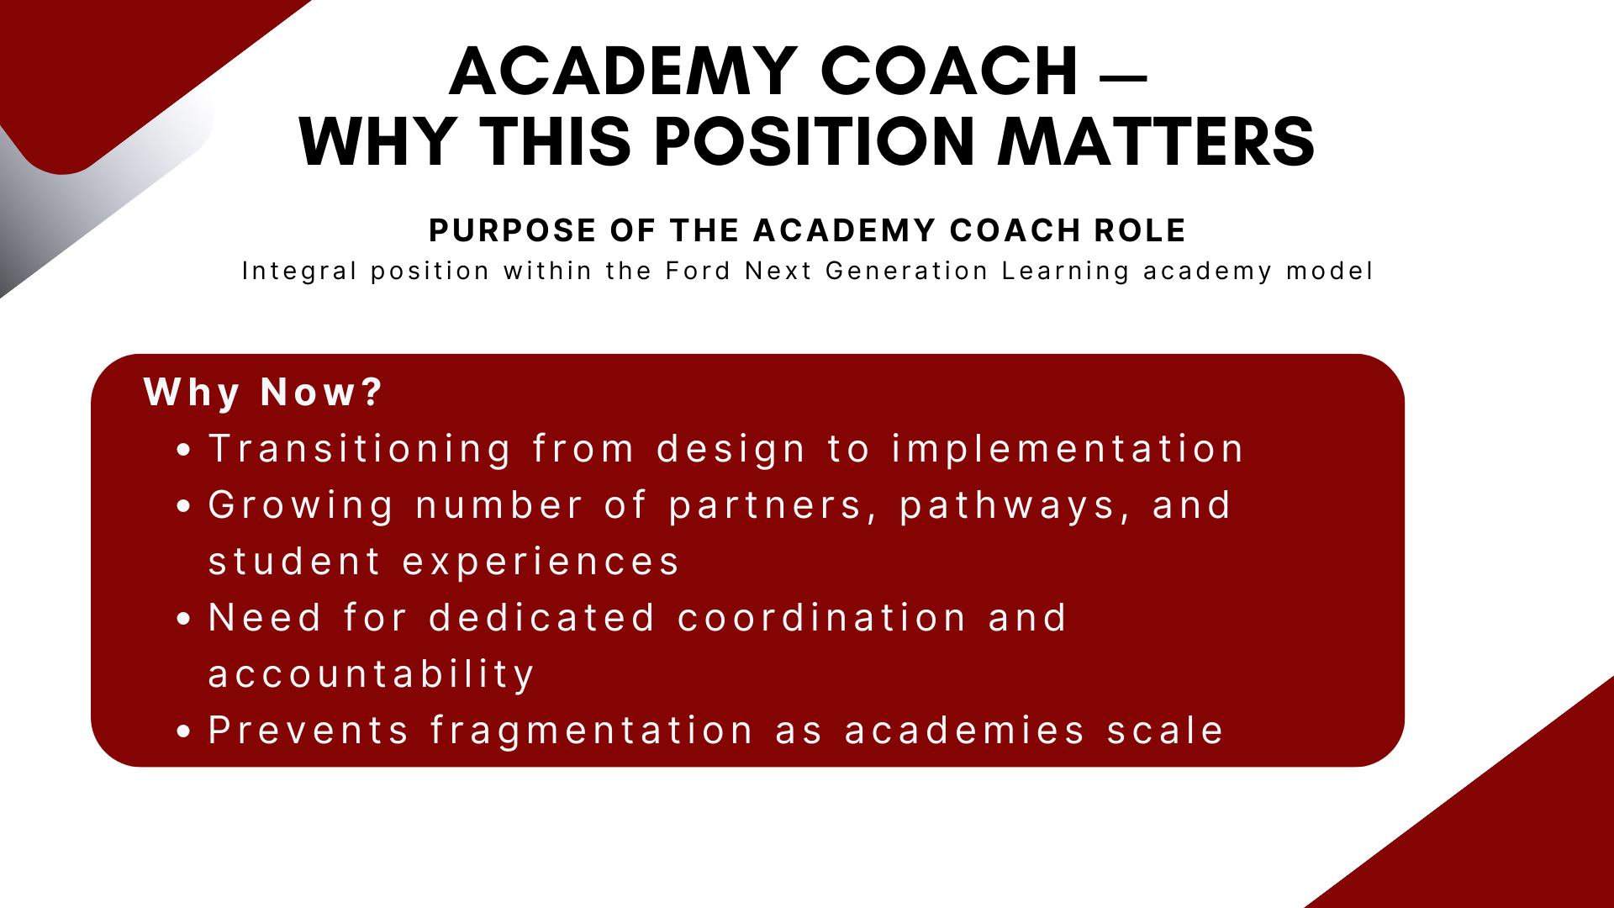
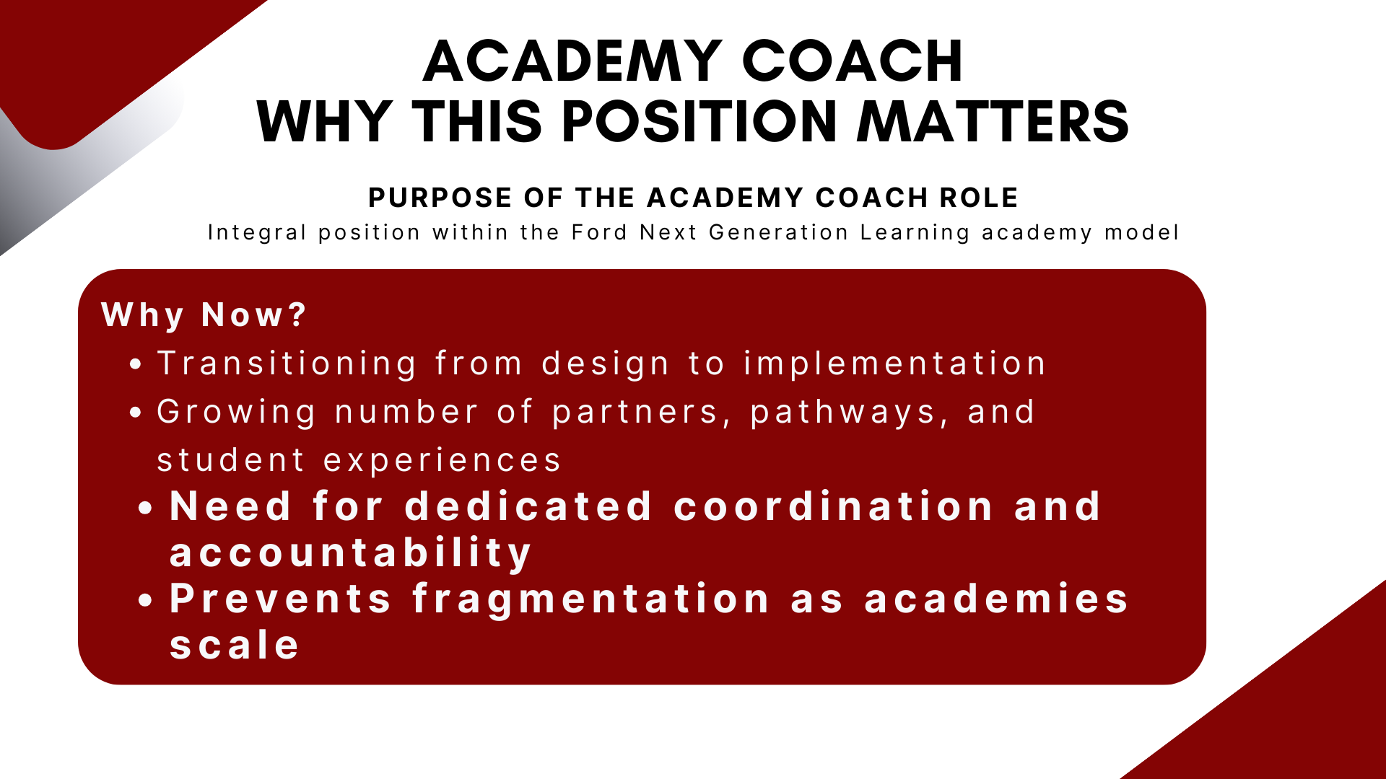

Slide 14
