Slide 1


Redesigning a
Successful
High School
Strong Schools.
Strong Communities.
Strong Futures.

Slide 2

Today’s Goals Are to Share …
01
Our journey
02
Opportunities and challenges
03
Stakeholder activities and engagement
04
Our current status
Notes:
Lisa - provide a quick overview of the history of MCHS - Consolidation of three high schools, house structure, variety of opportunities for students, student success. Our goals today are to share …

Slide 3
Our Journey
01
Why fix it if not broken?
02
Were we meeting the needs of all students?
03
What would be initial changes?
Notes:
Jonathan- share success of MCHS, so why fix it? Comment on meeting all student needs and our challenges with CTE course offerings. Initial changes as I see it would be addressing co-op, the initial moves in the building, moving to A/B block and addition of Herd Time, and charing us all to be ready to move forward.

Slide 4
Phase 1
01
Changes in Leadership
02
Prichard Grant
03
Jobs for America’s Graduates
04
Freshman Academy
Notes:
Miranda - share leadership changes which would include JSmith becoming principal, assistant principal changes. MCPS receiving Prichard grant. Adding JAG, you being hired, and program success. Initial launch of FA and how it has now changed.

Slide 5
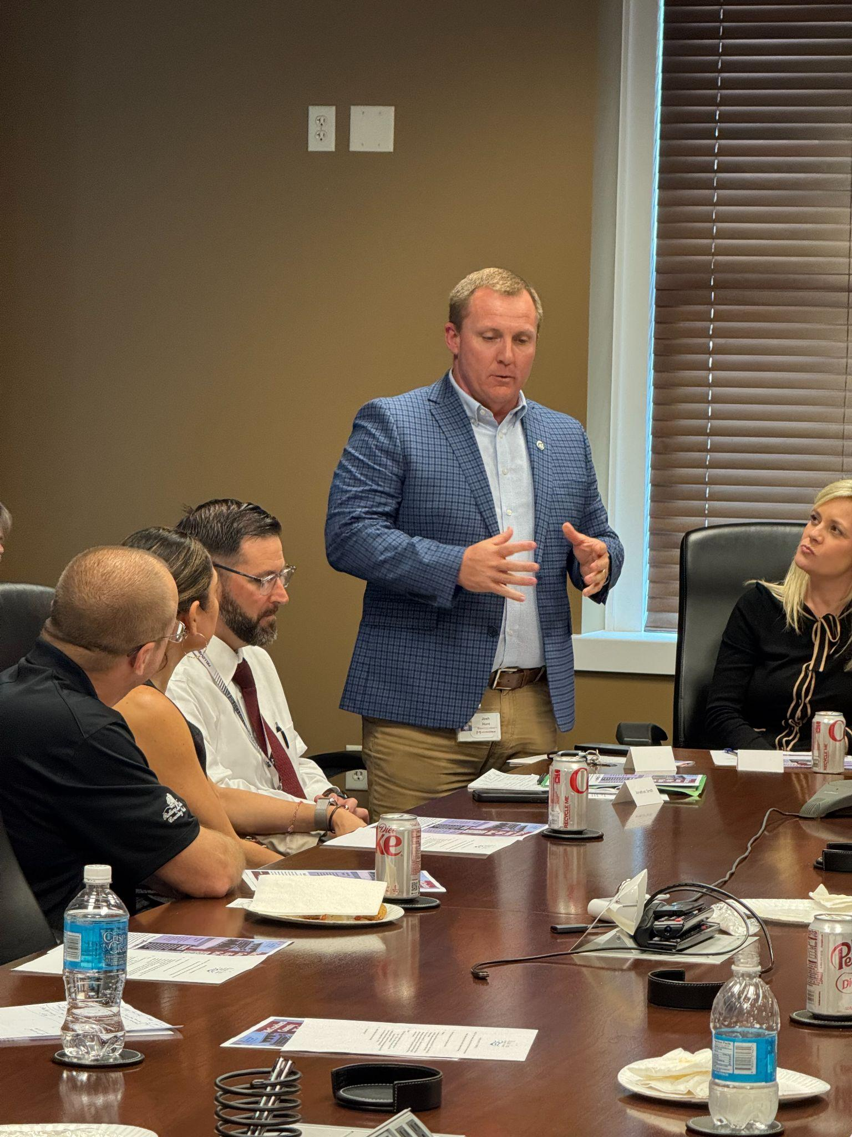

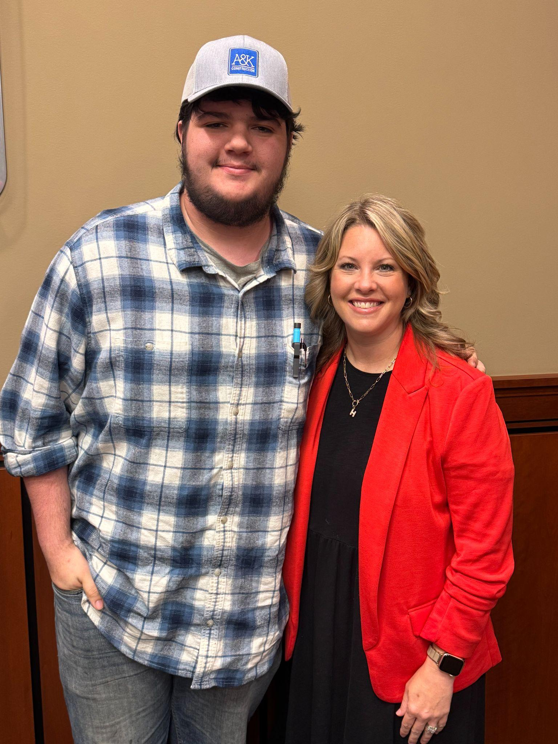

Slide 6

01
Ford NGL
02
Community stakeholders
Phase 2
Empowering Generations for a Better Future.
We work together to create meaningful pathways, strong partnerships, and a future where ALL students are prepared to succeed in life, work, and community.
Strong Schools.
Strong Community.
Strong Future.
03
Our why and PoG
04
Academy Coach
Notes:
Tag Team - Jonathan, Miranda, and Lisa - We reached out to Ford NGL. Even before this ask, we had started to better engage stakeholders through JAG and other events. Through stakeholder engagement and Ford’s help, created our why and new PoG. An activity might be asking participants to share their strongest partners/stakeholders, think about their PoG and share our new one. Do we need to add a slide with our why statement?
Pause for quick activity - We would like for you to think about your community stakeholders for a minute. Is there a list, who has this this, are engagements hit or miss and one and done. Asset Map completion and will build on this.

Slide 7
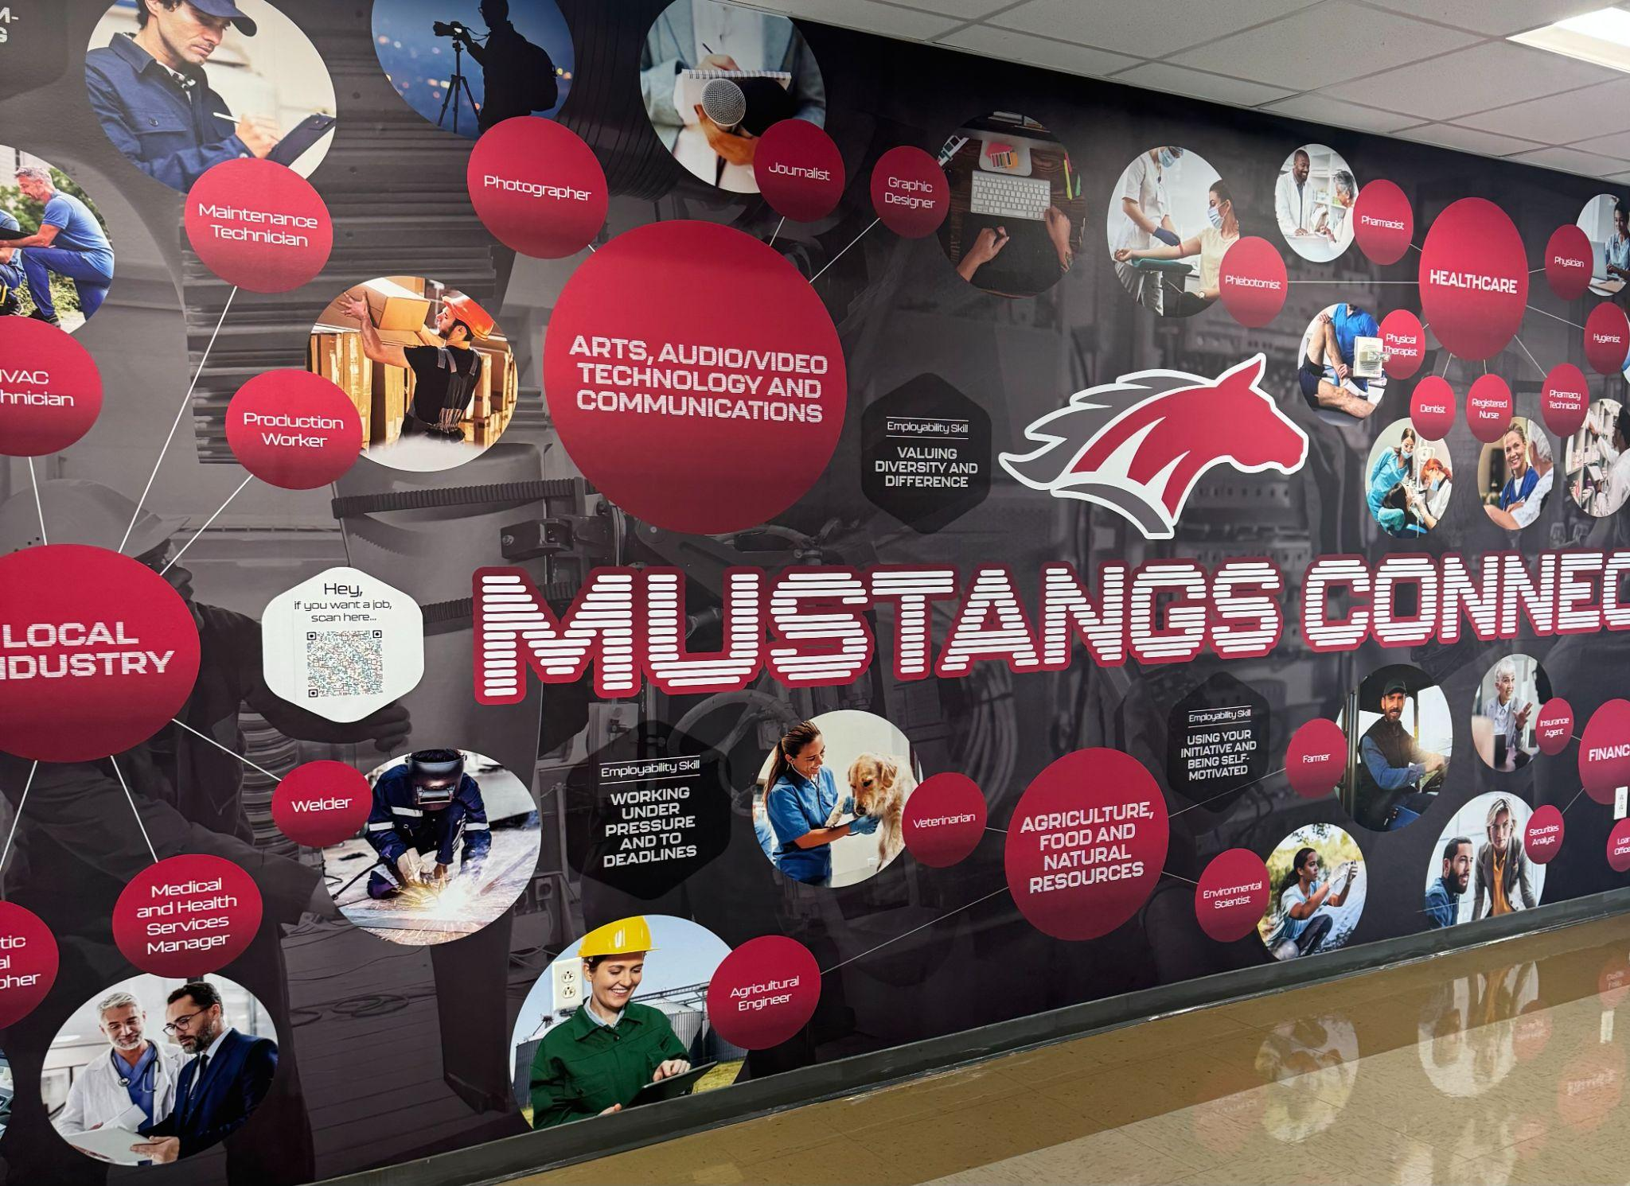

Slide 8

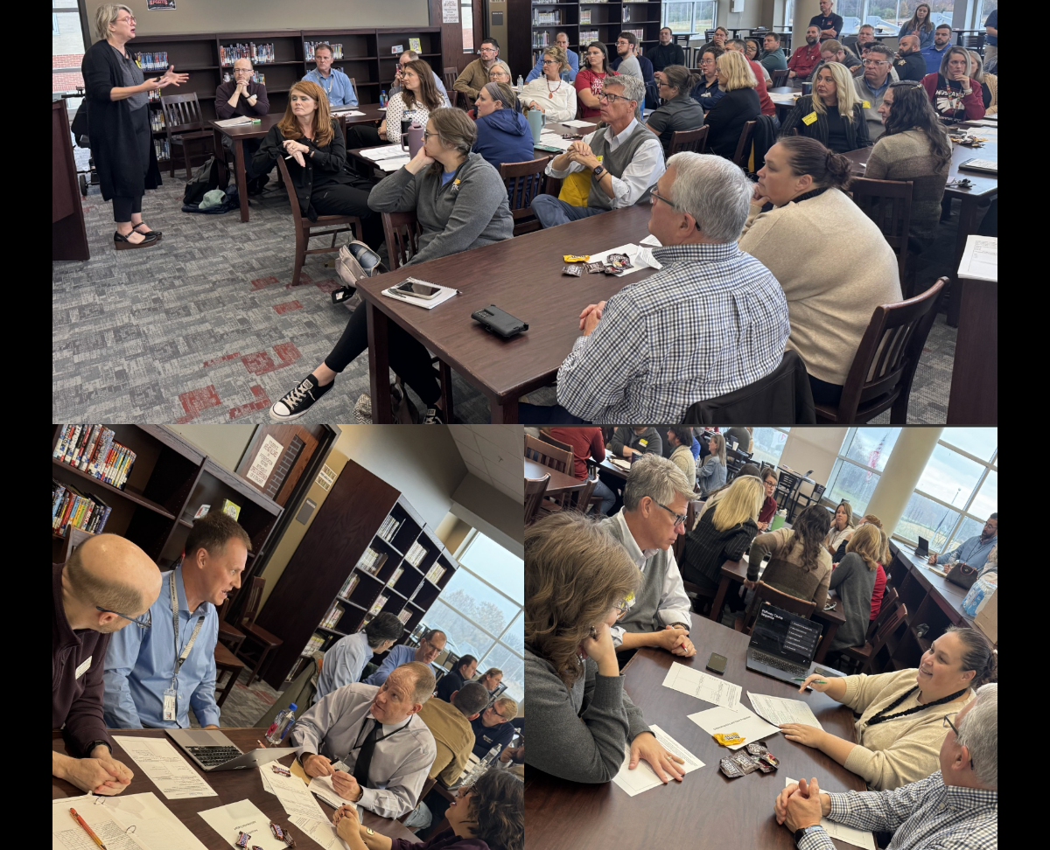
Phase 3
01
Evaluating pathways
July 2025
02
Gaining stakeholder input
25-26 school year
Four square project
Notes:
Andrea - If I remember correctly, you and Kristy started work on this at CTE Conference last year. Explain the process we went through to start evaluating our pathways - numbers, what might need to sunset or what might need to be added; all the work you did on pathway document and the challenges with engaging teachers; share how FA did their showcase for each pathway and how Health Science was different. Andrea and Lisa will discuss the 4-Squares activitie and this might be something for attendees to do.

Slide 9
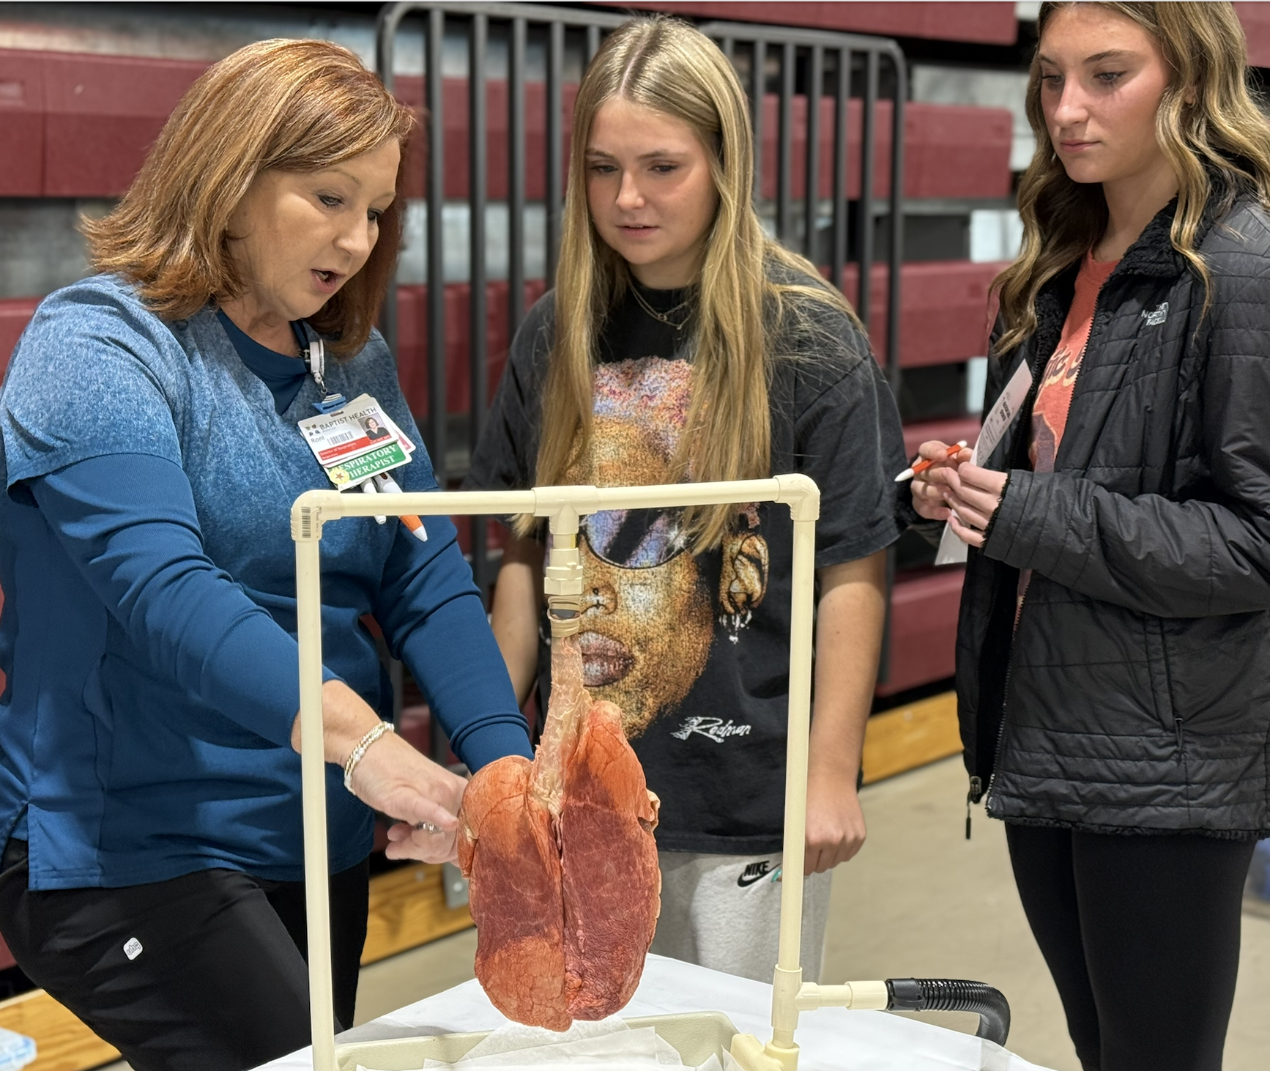
Phase 3
03
Engaging pathway teachers
25-26 school year
Teacher Survey
04
Career Pathways Guide
View Flip-book
05
Showcasing pathways
Connecting students with local industry experts.
Notes:
Andrea - If I remember correctly, you and Kristy started work on this at CTE Conference last year. Explain the process we went through to start evaluating our pathways - numbers, what might need to sunset or what might need to be added; all the work you did on pathway document and the challenges with engaging teachers; share how FA did their showcase for each pathway and how Health Science was different. Andrea and Lisa will discuss the 4-Squares activitie and this might be something for attendees to do.

Slide 10
Phase 4
06
Building the schedule
07
Advising vs. Scheduling
FA Academic Advising Form
D
08
Empowering Students
09
Naming Academies
10
Launching The Academies of McCracken County
Notes:
Everyone can help with this slide - Thinking comments on our Schedule Committee. How we shared scheduling info during Herd Time and Herd Teachers being trained to help with this process; students selecting their classes given the advising sheets. Using stakeholder input we named academies, and will launch in the fall.

Slide 11

Our Words of Wisdom
01
Students First
02
Continued Engagement
03
Open & Honest Communication
04
Patience
05
Evaluation
06
Celebrate
Notes:
Another tag team - Everything we have done is with the mindset of ALL students first, we have continued to engage partners/all stakeholders, the creation of the Mustang Memo, need to have patience, need to evaluate, and definite need to celebrate.

Slide 12
Flipbook and CTE lessons for Freshman Academy
andrea.heisner@mccracken.kyschools.us
Executive Principal
jonathan.smith@mccracken.kyschools.us
Academy Coach
miranda.hunt@mccracken.kyschools.us
College and Career Coach
lisa.stephenson@mccracken.kyschools.us

